Slide 1

Data Limitations and Data Mining
Caitie Kuempel
PhD Candidate
@cdkuempel

Slide 2
Data Types:
Primary Data:
Data that you collect yourself, usually with a specific purpose in mind
Secondary Data:
Data that have already been collected by and “readily available” from other sources
What is Data Mining?
Analyzing data from different perspectives and summarizing it into useful information
Notes:
Secondary data- ask post-docs, look at other literature, etc.

Slide 3
Where to find secondary data:
Most reliable sources are published:
Government data
Data used in other published papers
International Bodies
Reports from Committees and Commissions
Private publications- commercial and research institutes
RELIABLE Online databases
Ask supervisors, post-docs, see what others have used!
Notes:
Secondary data- ask post-docs, look at other literature, etc.

Slide 4
Advantages:
Economical- saves efforts and expenses
Saves time
Easier to make out gaps or deficiencies in what additional information needs to be collected
Allows for longitudinal studies, larger scale/international studies and comparative studies through the combinations of multiple datasets, which may otherwise not be possible
Reanalysing data can lead to new and unexpected discoveries or verify previous results

Slide 5
Disadvantages:
Data collected for some other purpose
No control over how the data was collected
May not be very accurate
Mismatching units of measurements
Differing definitions used to clarify data
Data may be outdated
Lack of information needed to assess the credibility of data
A number of assumptions have to be made
Notes:
Usually data is collected with a concrete idea in mind of how it will be used/analyzed
Quantity is not synonymous with appropriateness

Slide 6
Evaluation of Secondary Data:
Accessibility/Availability
Reliability
Relevance
Suitability

Slide 7
Accessibility:
Open Access
Anyone is free to use, reuse and redistribute it
Usually only need to cite source
Creative Commons License
Varying levels of use
Conditions apply….
Potentially need to think of aspects such as co-authorship
Notes:
Rob is going to go into this in more detail

Slide 8
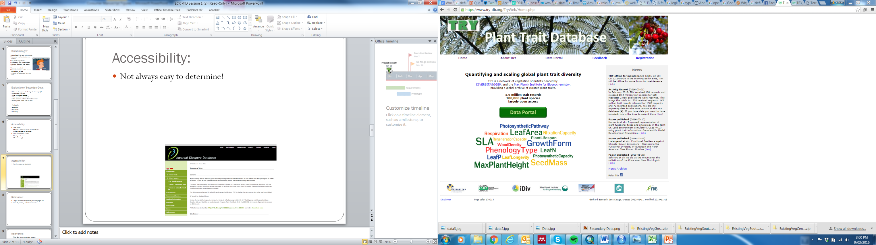
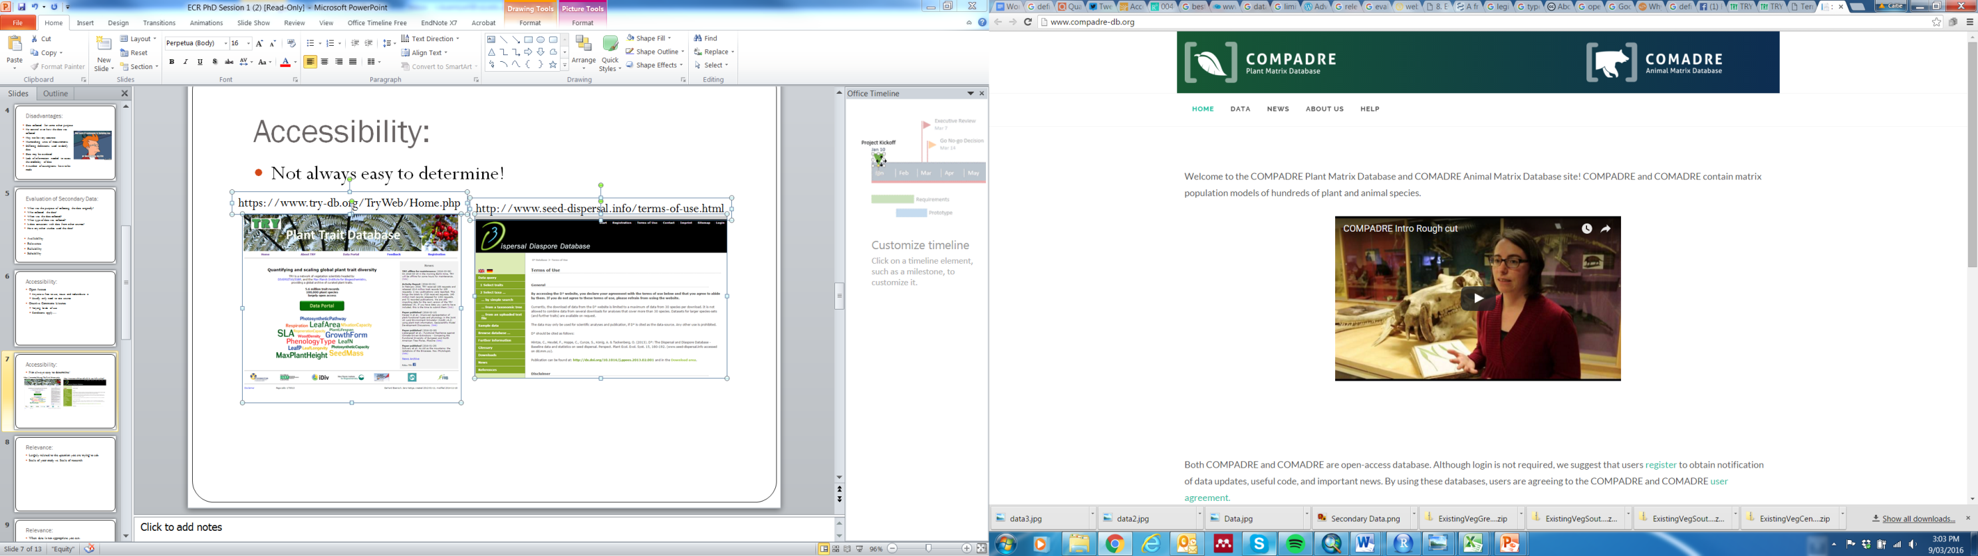
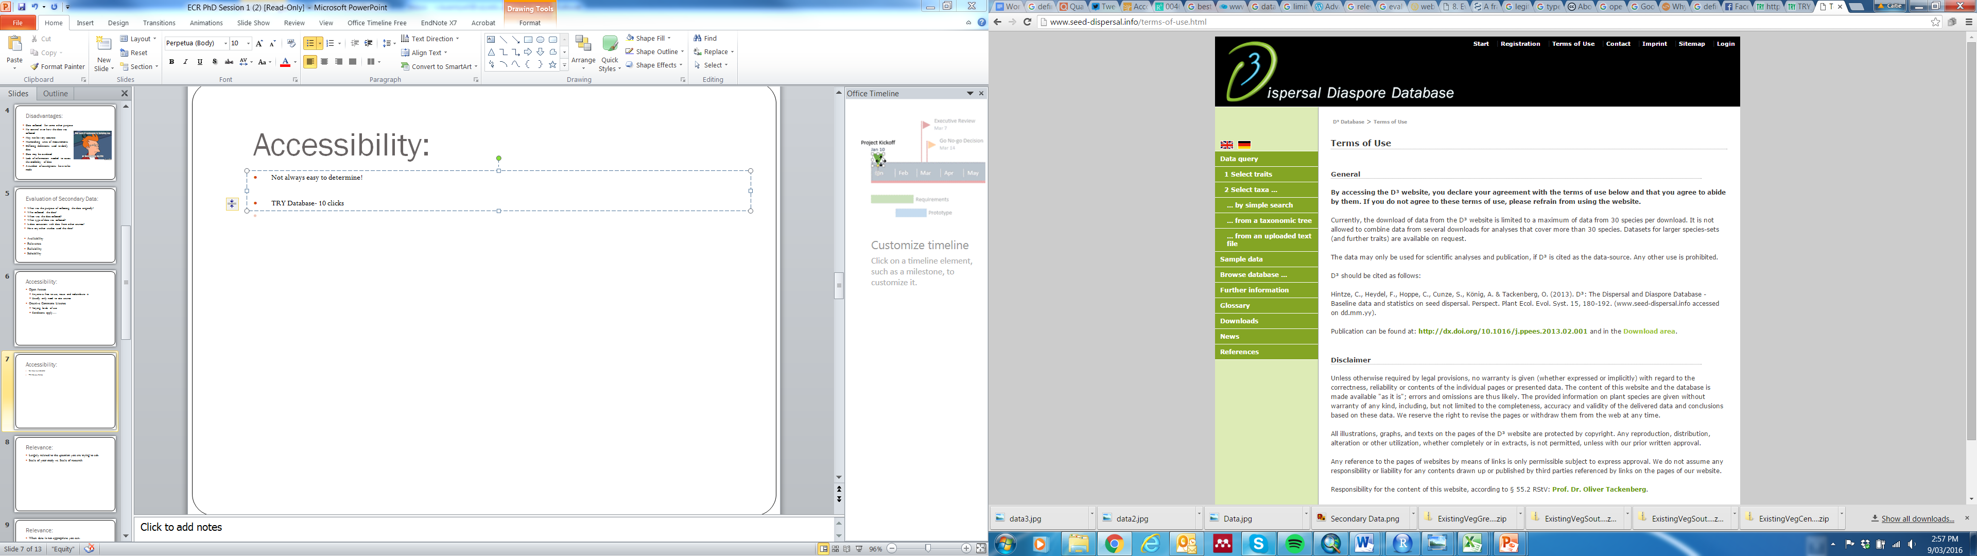
Accessibility:
Not always easy to determine!
https://www.try-db.org/TryWeb/Home.php
http://www.seed-dispersal.info/terms-of-use.html
http://www.compadre-db.org/
Notes:
TRY hardest
D3 2nd hardest
COMPADREW very strait forward

Slide 9
Reliability:
What’s the source of the data?
Has it been published?
Has it been used before?
What was the purpose of collecting the data originally?
Who collected the data?
When was the data collected?
What type of data was collected?
Is data consistent with data from other sources?
Notes:
Quantity is not synonymous with appropriateness

Slide 10
Relevance:
Have others used this data to answer similar questions?
When was the data collected?
Is it the most up-to-date?
Are collection techniques, etc. still valid?
Can it be used or manipulated to answer your research question?
Notes:
Quantity is not synonymous with appropriateness

Slide 11
Relevance:
When data is not appropriate you can:
1) Answer your research question partially with the subsequent lack of validity
2) Reframe your question around what data is available
3) Find an alternative dataset which is more suitable or collect your own data
Notes:
Quantity is not synonymous with appropriateness

Slide 12
Suitability:
Download the data and see what’s there!
What percentage of the data records have a value?
Dealing with N/As or missing data
Do data values/definitions change or drop out over time?
Are values entered in the same format?
Could be due to errors in data set, errors in data entry, or automated data process
Notes:
Quantity is not synonymous with appropriateness
May choose methods to deal with these if possible or may need to find new dataset

Slide 13
Suitability:
Think about scale
Check to see if there are other, similar data sources and compare them in terms of the question you are asking
Are there any other proxies you should use or consider?
May have to modify your question or find new data
Notes:
Quantity is not synonymous with appropriateness

Slide 14

Demography and Life History Traits:
Incomplete Data
Strong taxonomic biases
Geographic biases
Values can change based on whether the measurements are made on wild vs. captive animals
Notes:
Quantity is not synonymous with appropriateness

Slide 15
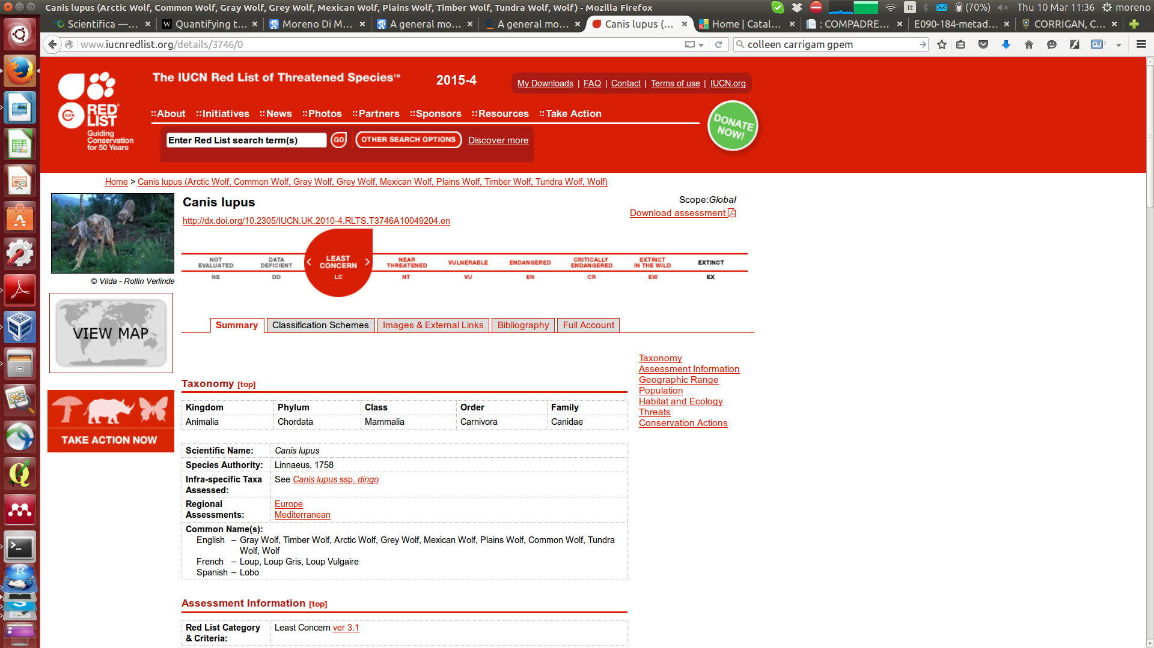
Species Extinction Risk and Threats:
Often outdated even though IUCN is updated- Extinction rates are not static
Reliability varies for species
Charismatic/well studied vs. Not
Notes:
Quantity is not synonymous with appropriateness

Slide 16
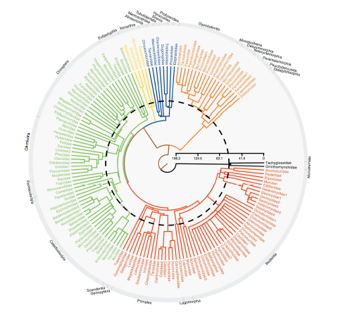
Taxonomy and phylogeny:
Taxonomy changes quickly- new species discovered, names changed, etc.
Different names for same species, changes through time
If using taxonomy as a proxy for phylogeny might want to use most recent
May effect comparability between studies
Notes:
Quantity is not synonymous with appropriateness

Slide 17
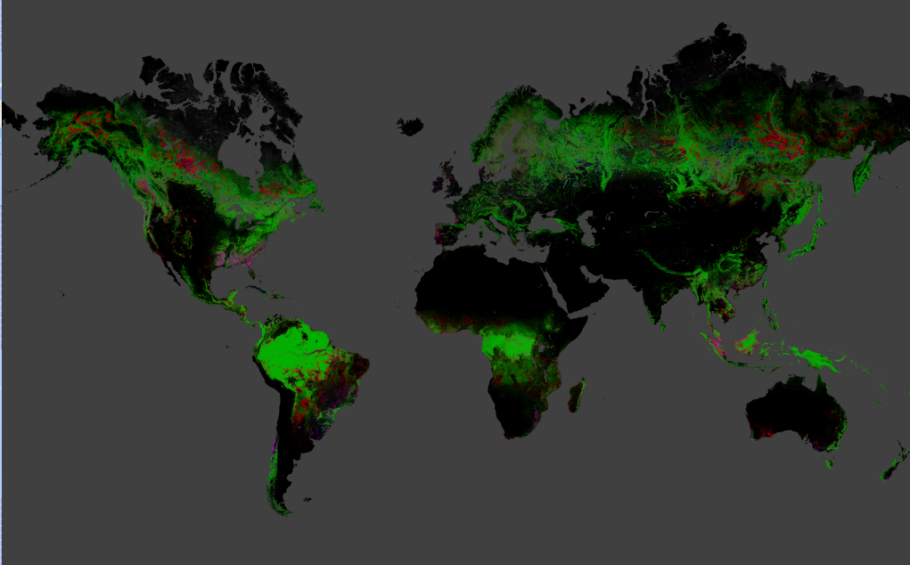
Land Cover and Satellite Data:
Calibration points are NOT evenly distributed- Africa vs. Europe
Issues with cloud cover, etc. may be hard to resolve
Notes:
Quantity is not synonymous with appropriateness

Slide 18
Land Cover and Satellite Data:
Hansen dataset
Can’t distinguish between natural forest cover and plantation
Example: Indonesia looks very green, which is likely due to the palm industry not natural vegetation
Notes:
Quantity is not synonymous with appropriateness

Slide 19
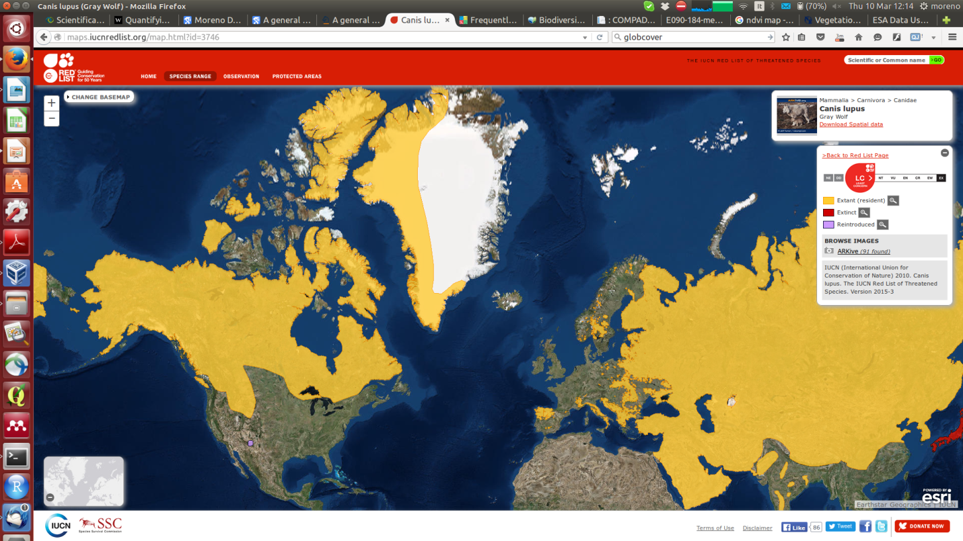
Species Distribution:
Missing species- taxonomic resolution
Data deficient species (i.e. 24% of amphibians listed as Data Deficient)
Missing Ranges
Notes:
Quantity is not synonymous with appropriateness

Slide 20
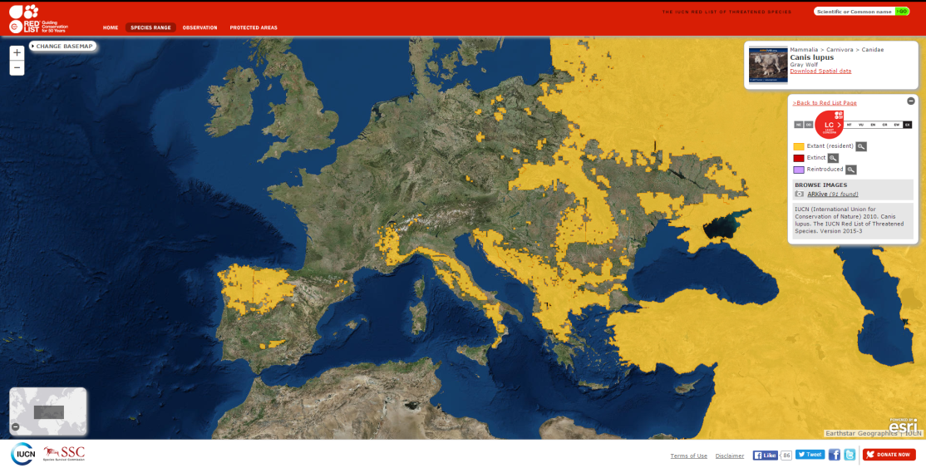
Species Distribution:
Example: Gray Wolf - Variations in range accuracy
Notes:
Gray wolf would be in every single PA in Russia when probably not really the case, as compared to Italy which has really accurate data

Slide 21
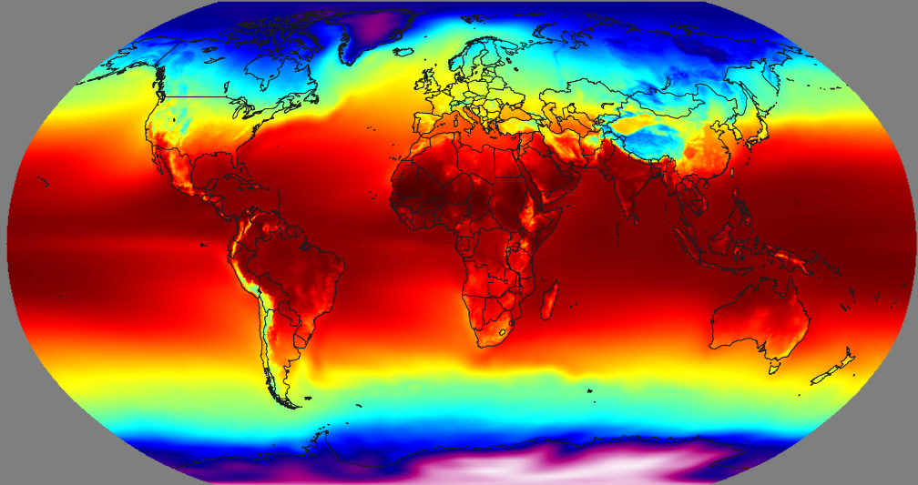
Climate:
Example: BIOCLIM
Often based on models not observations
May make data inaccurate for local/regional scale studies
Notes:
Quantity is not synonymous with appropriateness

Slide 22
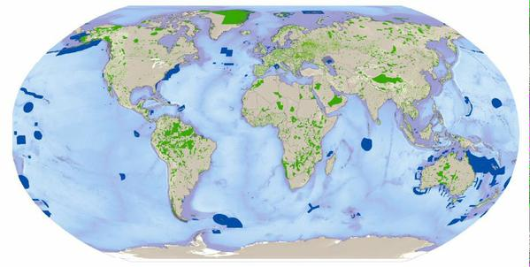
Protected areas, biodiversity areas:
Updated monthly- effects comparability to earlier studies
Info potentially not complete- voluntary reporting
Dealing with missing values
Points vs. Polygons- Buffering
Notes:
Quantity is not synonymous with appropriateness

Slide 23
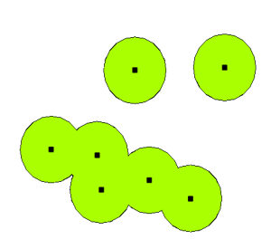
Protected areas, biodiversity areas:
Points vs. Polygons and Buffering
May want to include buffers for overall extent of protection
May NOT want to include buffers with species ranges, etc.
Could lead to large over or under estimation of biodiversity protection
Notes:
Di Marco 2013 Conservation Biology- “Even a relatively small percentage of PAs with missing boundaries can result in very large over or under estimation of biodiversity protection. Considering a portion of a species range protected when it is not could affect the perceived conservation status of the species. “False sense of protection for a species, or overallocation of conservation funds toward species that are relatively well protected”

Slide 24
Final thoughts:
See how others have dealt with data limitations and follow their methods
Can potentially save you a lot of time/headaches
Check the metadata
Keep in mind and be transparent about how limitations may effect your results/conclusions
Assumptions will almost always need to be made

